Slide 1
The Library
MANAGEMENT
SYSTEM
A Java-Based Object-Oriented AP-P-lication
Submitted by: Tapabrata Bakuli Department: CSE (IOTCSBT)
Target Users:
Students and Librarians in educational institutions

Slide 2
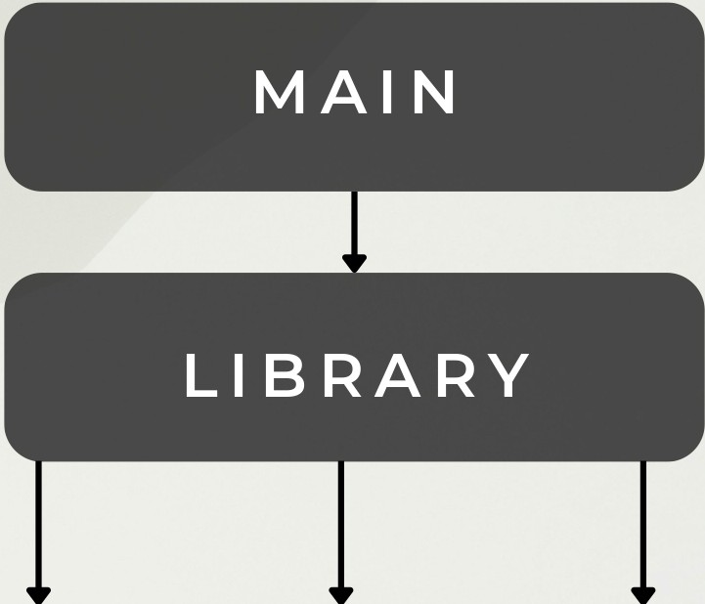
System Architecture
Architecture:
Main (CLI) Library (Logic) Models (Book, User, Transaction)
KeY. Classes:
Library - handles logic
User - abstract base class Book - stores book data Transaction - tracks operations
Package:
com.library (modular structure)
BOOK
USER
TRANSACTION

Slide 3
OOP Concepts
>rary-iava-app > src > com > library > J Library.Java
Abstraction
>Implemented using abstract User class defining common behavior
Inheritance
>Student and Librarian classes extend User for role specialization
PolY.moq hism
>getMaxBorrowlimit() overridden for different user types
EncaQsulation
>Private fields with getters/setters ensure controlled data access
5 public class Library {
41 public User findUserByid(String id) 42
44
45
46
47
48
49
59
51
52
53
54
55
56
57
58
59
69
61
62
63
64
65
66
67
68
69
79
_{t]}for (User user : users) {
..LI \U::tc1 .yct....LU\ J .c"4ua\..;)..1.y11u1c\..a::.c\..LU/1
I Cl..UI II U;:)CI r
}
return null;
public boolean issueBook(String :d, String sbn){ User user= findUserByid(userid);
Book book= findBookByisbn(isbnJ;
if (user == null) {
System.out.println("Error: User not found."); return false;
if (book == null) {
System.out.println("Error: Book not found."); return false;
if (!book.isAvailable()J {
System.out.println("Error: Book is already borrowed."); return false;
if (user.getBorrowedCount(J >= user.getMaxBorrowLimit(JJ { System.out.println("Error: User has reached borrowing limit."); return false;
book.setAvailable(false); user.incrementBorrowed();
ROBLEMS
OUTPUT DEBUG CONSOLE TERMINAL PORTS

Slide 4
Technical Highlight
>rary-iava-app > src > com > library > J Library.Java
5 public class Library {
41 public User findUserByid(String id){ 42
44
45
46
47
48
49
59
51
52
53
54
55
56
57
58
59
69
61
62
63
64
65
66
67
_{t]}for (User user : users) {
..LI \U::tc1 .yct....LU\ J .c"4ua\..;)..1.y11u1c\..a::.c\..LU/1
I Cl..UI II U;:)CI r
}
return null;
Logic:
Validates availabilitY. and borrowing limits
public boolean issueBook(String :d, String sbn){ User user= findUserByid(userid);
Book book= findBookByisbn(isbnJ;
if (user == null) {
System.out.println("Error: User not found."); return false;
Why
Prevents invalid OP-erations and ensures SY.Stem consistencY.
if (book == null)
System.out.println("Error: Book not found."); return false;
if (!book.isAvailable()J
System.out.println("Error: Book is already borrowed."); return false;
if (user.getBorrowedCount(J >= user.getMaxBorrowLimit(JJ { System.out.println("Error: User has reached borrowing limit."); return false;

Slide 5
c<beastvengeances admin)-[-/library-java-app/src]
$ javac com/library/*.Java
C(beastvengeanceS admin)-[-/library-java-app/src]
$ Java com. library.Hain
Live Demo
Jrt
es com libra[Y. 10i<.class
10ILjava
rana class
>rarian.java irary class irary.java
... class
iin.java
.dent class
udent.java
LIBRARY HANAGEHENT SYSTEM
Add a New Book
Register a New User
Show Full Inventory
Show Registered Users
Search Books by Title
Issue a Book (Borrow)
Return a Book
Exit Application
Please select an option (1-8): 3
ans.act
on c,ass
--- Current Book Inventory ---
[ISBN01J Clean Code by Robert Hartin - Available [ISBN02) Introduction to Algorithms by CLRS - Available [ISBN03) Effective Java by Joshua Bloch - Available
LIBRARY HANAGEHENT SYSTEM
ansaction.java
er class
,er.java gnore ll>ME.md
Add a New Book
Register a New User
Show Full Inventory
Show Registered Users
Search Books by Title
Issue a Book (Borrow)
Return a Book
Exit Application
Please select an option (1-8): 4
--- Registered Library Users ---
[Sl01) Alice Student I Type: Student [l505) Bob librarian I Type: librarian
Borrowed: G/3 Borrowed: G/10
LIBRARY HANAGEHENT SYSTEM
Add a New Book
Register a New User
Show Full Inventory
Show Registered Users
Search Books by Title
Issue a Book (Borrow)
Return a Book
Exit Application
Please select an option (1-8): 5 Enter partial title to search: clean
[ISBN01) Clean Code by Robert Hartin - Available

